Slide 1







WORLD VENTILATION DAY ROUND TABLE 2026
Five networks.
One motion.
You decide.
Friday 6 November 2026 · 12:00 to 13:00 GMT · Chaired by Marco-Felipe King
Notes:
Holding slide from 11:55 while people join. Say hello to each speaker as they arrive and check names, cameras and microphones. Confirm everyone has the running order. At 12:00, start the recording, then move to the next slide.

Slide 2
A round table with a difference
WELCOME
Recorded
Questions
Two votes
This session is recorded and will be shared on the HBN website.
Put questions in the chat at any time. We’ll take them at 12:35.
You’ll vote on the motion now, and again at the end.
World Ventilation Day Round Table 2026 · #WorldVentil8Day
Notes:
Welcome, everyone, and happy World Ventilation Day, a couple of days early as the 8th falls on a Sunday. I’m Marco-Felipe King, Director of the Healthy Buildings Network at Leeds, and I’ll be chairing. Housekeeping: we’re recording, so please keep microphones off. Questions go in the chat at any time, and we’ll come to them at 12:35. And you’ll vote twice: once now and once at the end, so we can see whether anyone changes their mind.

Slide 3
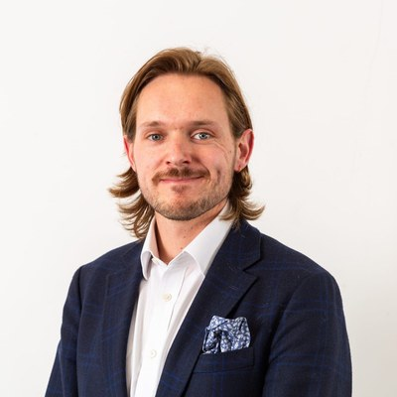
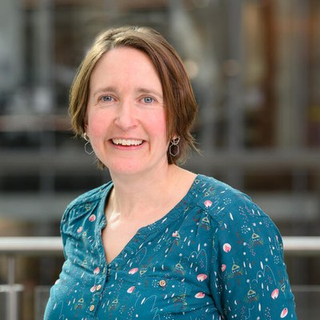
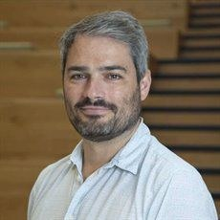
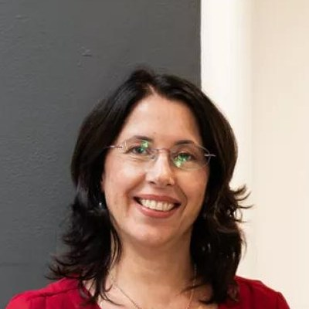
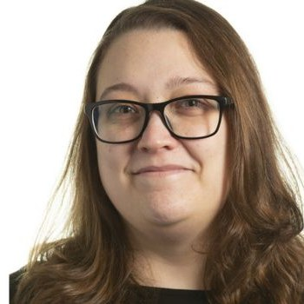
Five networks, one conversation
THE NETWORKS
Doug Booker
Abigail Hathway
Bruño Fraga
Marcella Ucci
Irene Mussio
HESTIA
Air Hub
BreatHE IN
UKIEG
Healthy Buildings Network
World Ventilation Day Round Table 2026 · #WorldVentil8Day
Notes:
Five networks are taking part today: HESTIA, Air Hub, BreatHE IN, the UK Indoor Environments Group and the Healthy Buildings Network. Each has sent one person to make its case. Doug Booker for HESTIA, Abigail Hathway for Air Hub, Bruño Fraga for BreatHE IN, Marcella Ucci for UKIEG, and my HBN co-lead Irene Mussio for the Healthy Buildings Network. Speakers aren’t necessarily giving their personal views; they’ve been asked to be provocative.

Slide 4
Should the UK set a legally binding indoor air quality limit now, before the evidence is complete?
THE MOTION
World Ventilation Day Round Table 2026 · #WorldVentil8Day
Notes:
Here’s today’s motion. Read it out slowly. The interesting part is the second half: almost everyone here agrees indoor air matters. The question is whether we act before the evidence is complete, or wait until we’re sure.

Slide 5
Where do you stand right now?
OPENING VOTE
Yes
No
Undecided
Vote at: [poll link or QR code]
World Ventilation Day Round Table 2026 · #WorldVentil8Day
Notes:
Launch the poll now. Give people about 60 seconds. Read out the split briefly, and note the numbers for the result slide at the end. Then: let’s see whether our five speakers can move you.

Slide 6
The next hour
RUNNING ORDER
Time | What happens
12:00 | Welcome and opening vote
12:05 | Round 1: five provocations, 3 minutes each
12:20 | Round 2: challenges, 3 minutes each
12:35 | Your questions
12:45 | Commitments, 1 minute each
12:55 | Closing vote and result
World Ventilation Day Round Table 2026 · #WorldVentil8Day
Notes:
Quick tour of the hour. All five provocations first, so you know where each speaker stands. Then a round of challenges, audience questions, a commitments round, and the closing vote. We finish at 13:00 sharp.

Slide 7
Three moves for each speaker
HOW IT WORKS
ROUND 1
ROUND 2
CLOSE
Provocation
Challenge
Commitment
3 minutes and one slide: a claim and an ask. Hard stop.
1 minute to put one sharp question to the next speaker. 2 minutes to respond.
One thing each network will do, or wants to see, by World Ventilation Day 2027.
World Ventilation Day Round Table 2026 · #WorldVentil8Day
Notes:
Each speaker gets three moves. A three-minute provocation with one slide; I’ll give a 30-second warning and stop people at three minutes, sorry in advance! Then in Round 2 each speaker puts one challenge to the next speaker, who has two minutes to respond. And at the end, one commitment each.

Slide 8

Five provocations
ROUND 1
3 minutes each, in this order: Doug · Abigail · Bruño · Marcella · Irene
Notes:
Round 1. Five provocations, three minutes each, no interruptions. Order: Doug, Abigail, Bruño, Marcella, Irene. Have a timer ready and give the 30-second warning in the chat or verbally.

Slide 9
Doug Booker
PROVOCATION 1 OF 5
HESTIA
Arguing for the motion
3 minutes · one slide · hard stop
Notes:
Introduce Doug Booker from HESTIA, arguing for the motion. Start the 3-minute timer as they begin, warn at 30 seconds, and thank them at 3:00.

Slide 10
[Doug’s slide goes here]
HESTIA · DOUG’S SLIDE
Replace this placeholder with the slide received by 10:00 on Friday.
Notes:
Placeholder for Doug’s own slide. Swap in the slide they send by 10:00, or share their slide from their own file.

Slide 11
Abigail Hathway
PROVOCATION 2 OF 5
Air Hub
Arguing against the motion
3 minutes · one slide · hard stop
Notes:
Introduce Abigail Hathway from Air Hub, arguing against the motion. Start the 3-minute timer as they begin, warn at 30 seconds, and thank them at 3:00.

Slide 12
[Abigail’s slide goes here]
AIR HUB · ABIGAIL’S SLIDE
Replace this placeholder with the slide received by 10:00 on Friday.
Notes:
Placeholder for Abigail’s own slide. Swap in the slide they send by 10:00, or share their slide from their own file.

Slide 13
Bruño Fraga
PROVOCATION 3 OF 5
BreatHE IN
Arguing for the motion
3 minutes · one slide · hard stop
Notes:
Introduce Bruño Fraga from BreatHE IN, arguing for the motion. Start the 3-minute timer as they begin, warn at 30 seconds, and thank them at 3:00.

Slide 14
[Bruño’s slide goes here]
BREATHE IN · BRUÑO’S SLIDE
Replace this placeholder with the slide received by 10:00 on Friday.
Notes:
Placeholder for Bruño’s own slide. Swap in the slide they send by 10:00, or share their slide from their own file.

Slide 15
Marcella Ucci
PROVOCATION 4 OF 5
UKIEG
Arguing for the motion
3 minutes · one slide · hard stop
Notes:
Introduce Marcella Ucci from UKIEG, arguing for the motion. Start the 3-minute timer as they begin, warn at 30 seconds, and thank them at 3:00.

Slide 16
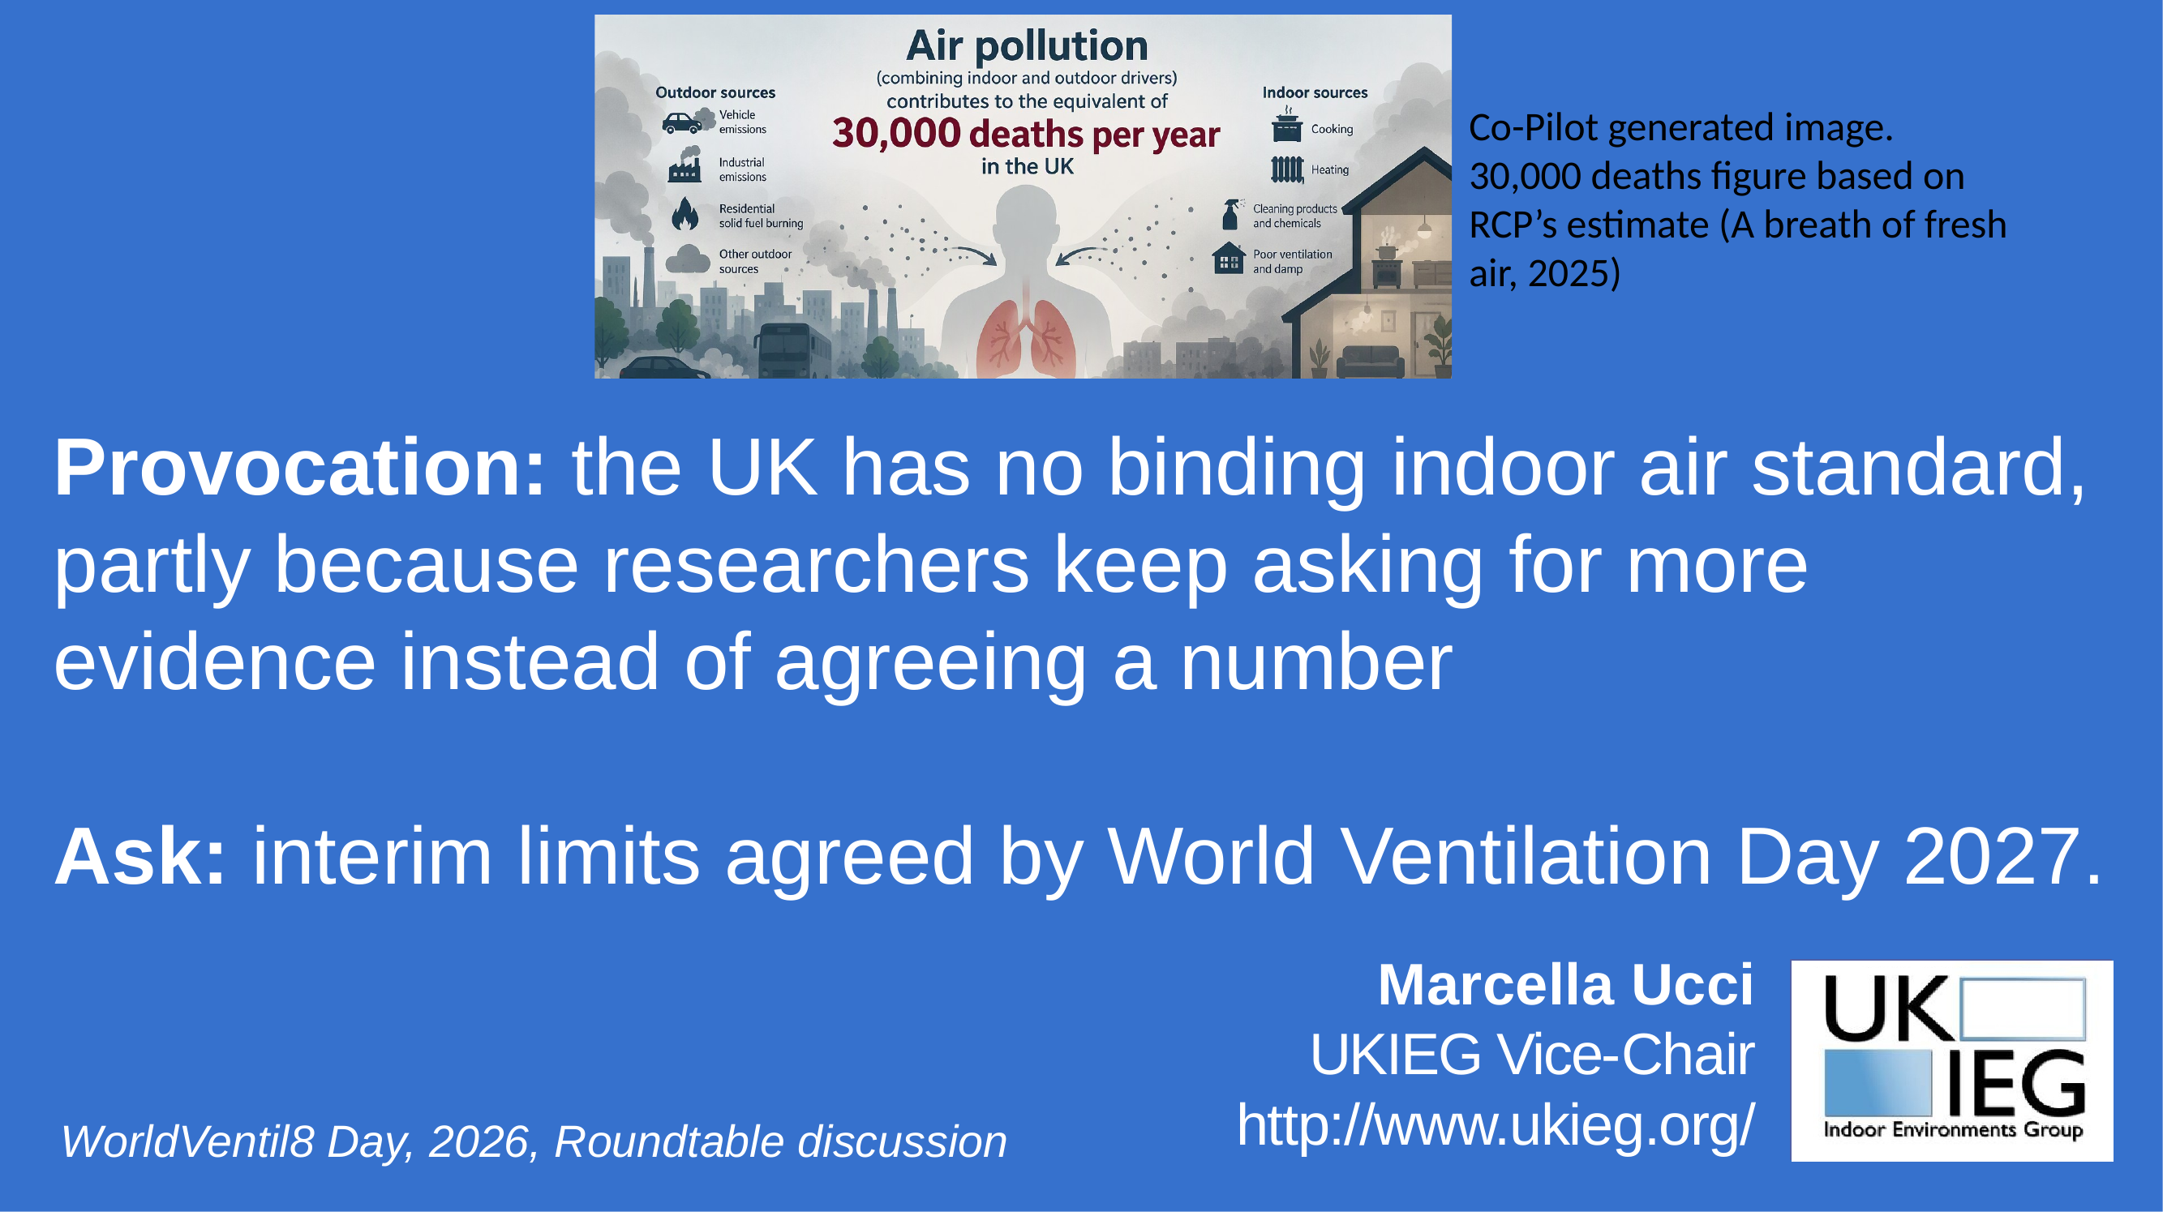
Notes:
Marcella’s slide as sent. Replace it if she sends an updated version before 10:00.

Slide 17
Irene Mussio
PROVOCATION 5 OF 5
Healthy Buildings Network
Arguing against the motion
3 minutes · one slide · hard stop
Notes:
Introduce Irene Mussio from Healthy Buildings Network, arguing against the motion. Start the 3-minute timer as they begin, warn at 30 seconds, and thank them at 3:00. Side to confirm: check Irene’s final slide, which earlier read as a qualified yes.

Slide 18
[Irene’s slide goes here]
HEALTHY BUILDINGS NETWORK · IRENE’S SLIDE
Replace this placeholder with the slide received by 10:00 on Friday.
Notes:
Placeholder for Irene’s own slide. Swap in the slide they send by 10:00, or share their slide from their own file.

Slide 19

Challenges: one sharp question each
ROUND 2
Irene
Doug
Abigail
Bruño
Marcella
challenges
challenges
challenges
challenges
challenges
Doug
Abigail
Bruño
Marcella
Irene
1 minute to challenge · 2 minutes to respond
Notes:
Round 2. Each speaker puts one sharp question or counterpoint to another speaker’s provocation: one minute to challenge, two minutes to respond. We go in the order of the pitches, so Doug responds first, to Irene. I’ll put each provocation back on screen so we all remember it.

Slide 20

“Airtight retrofit without verified ventilation is a health intervention nobody consented to.”
CHALLENGE 1 OF 5
Irene
Doug
DOUG’S PROVOCATION (HESTIA)
Ask: No public retrofit funding without post-occupancy IAQ checks.
Irene: 1 minute · Doug: 2 minutes
Notes:
Irene, you’re arguing against the motion. What’s your challenge to Doug? One minute. Then Doug, two minutes to respond. Update the provocation text here if Doug’s final one-liner changed.

Slide 21
“Stop telling people to open windows: in many homes the problem is sources, not air change.”
CHALLENGE 2 OF 5
Doug
Abigail
ABIGAIL’S PROVOCATION (AIR HUB)
Ask: Source control and filtration before ventilation rates.
Doug: 1 minute · Abigail: 2 minutes
Notes:
Doug, you’re arguing for the motion. What’s your challenge to Abigail? One minute. Then Abigail, two minutes to respond. Update the provocation text here if Abigail’s final one-liner changed.

Slide 22
“CO2 monitors have become theatre: measurement with no duty to act.”
CHALLENGE 3 OF 5
Abigail
Bruño
BRUÑO’S PROVOCATION (BREATHE IN)
Ask: Every sensor gets a named owner and an action threshold.
Abigail: 1 minute · Bruño: 2 minutes
Notes:
Abigail, you’re arguing against the motion. What’s your challenge to Bruño? One minute. Then Bruño, two minutes to respond. Update the provocation text here if Bruño’s final one-liner changed.

Slide 23
“The UK has no binding indoor air standard, partly because researchers keep asking for more evidence instead of agreeing a number.”
CHALLENGE 4 OF 5
Bruño
Marcella
MARCELLA’S PROVOCATION (UKIEG)
Ask: Interim limits agreed by World Ventilation Day 2027.
Bruño: 1 minute · Marcella: 2 minutes
Notes:
Bruño, you’re arguing for the motion. What’s your challenge to Marcella? One minute. Then Marcella, two minutes to respond. Update the provocation text here if Marcella’s final one-liner changed.

Slide 24
“Ventilation loses every budget fight because we report it in litres per second, not illness and cost.”
CHALLENGE 5 OF 5
Marcella
Irene
IRENE’S PROVOCATION (HEALTHY BUILDINGS NETWORK)
Ask: A health economist on every ventilation project.
Marcella: 1 minute · Irene: 2 minutes
Notes:
Marcella, you’re arguing for the motion. What’s your challenge to Irene? One minute. Then Irene, two minutes to respond. Update the provocation text here if Irene’s final one-liner changed.

Slide 25
Over to you
YOUR QUESTIONS
Put your questions in the chat or raise your hand.
World Ventilation Day Round Table 2026 · #WorldVentil8Day
Notes:
Ten minutes for audience questions. Group similar questions from the chat and direct each to one or two speakers. Keep answers short so several people can speak. Stop at 12:45.

Slide 26
One thing by World Ventilation Day 2027
COMMITMENTS
Something already in train, a personal commitment, or one thing you’d like to see happen.
Doug
Abigail
Bruño
Marcella
Irene
1 minute each, in pitch order
Notes:
Commitments round, one minute each in pitch order. It can be something already in train, a personal commitment, or one thing you’d like to see happen: nobody needs to commit their network formally today. Jot each one down, then sum up all five in a sentence before the vote. We’ll publish them with the recording and check back next World Ventilation Day.

Slide 27
Has anyone changed their mind?
CLOSING VOTE
Yes
No
Undecided
Vote at: [poll link or QR code]
Notes:
Relaunch the same poll. Read the motion again first. Give 60 seconds.

Slide 28
Did the room move?
THE RESULT
Before
After
Yes
[__%]
Yes
[__%]
No
[__%]
No
[__%]
Undecided
[__%]
Undecided
[__%]
World Ventilation Day Round Table 2026 · #WorldVentil8Day
Notes:
Fill in or read out the before and after figures. Name the swing: which way the room moved, and by how much. Thank the speakers.

Slide 29
Thank you
THANK YOU
All five commitments will be on healthybuildingsnetwork.org.
See you on World Ventilation Day 2027.
#WorldVentil8Day · #Collabor8Ventil8
Notes:
Thank the five speakers and networks, and everyone who joined. The recording and commitments will go on the HBN website. Stop the recording.

